Slide 1

ARSERVE MULTISERVICE COMPANY
Kicukiro-Kigali, Rwanda
www.arserve.co.rw
+250 782 340 750
Since 2018

Slide 2
About us
Arserve multiservice company.
Has been created as a solution to modern events organisation and execution, I have always been passionate about Hospitality and througout my carreer and academic life, I observed modern events was lacking a touch from a professional to be successful, that‘s how the idea came along.
We aim at providing Professional excellent services in Events with a touch of our passion for hospitality starting from small and Private to Medium and Large types of event and let our clients know that they can relax and let us do it for them.
We believe that as we grow and develop the firm we can achieve our vision which is to provide one stop center to all inquiries regarding any type of event from planning up to the execution stage, together with our contractors.
Arsene SHYAKA

Slide 3
Company History
05/01/2018
MM/DD/2020
MM/DD/2022
MM/DD/2023
We served more than 90 wedding services + small events
Recovering from COVID and did 70 Served Events
Delivered 100 events services and Catering to ceremonies
Kick off startup and early steps to our vision
We hosted the JAZZ Junction F&B Service + COVID pandemic season
In This Year we also expanded our network abroad
We Delivered 70 wedding + SEKA LIVE CONCERTS & still more to come
MM/DD/2019
MM/DD/2021
MM/DD/2022

Slide 4




Meet the Team
Arsene SHYAKA
Founder & CEO
Divin NTAGOZERA
COO & Director
Patrick SUGIRA
Marketing Manager
Yves IRADUKUNDA
Human Resources
Bella GASARO
Logistics Manager

Slide 5
Mission, Vision & Values
To enhance professionalism and dedicated to present exceptional services and provide extraordinary memories for every client in their events, We are happy to be there for you, Let us do it for you
Mission
Vision
We want to be the Hub/One Stop center, All in One Event destination
Serve, Responsibility, Discipline, Friendship
Values

Slide 6
ARSERVE MULTISERVICE COMPANY welcomes You

Slide 7
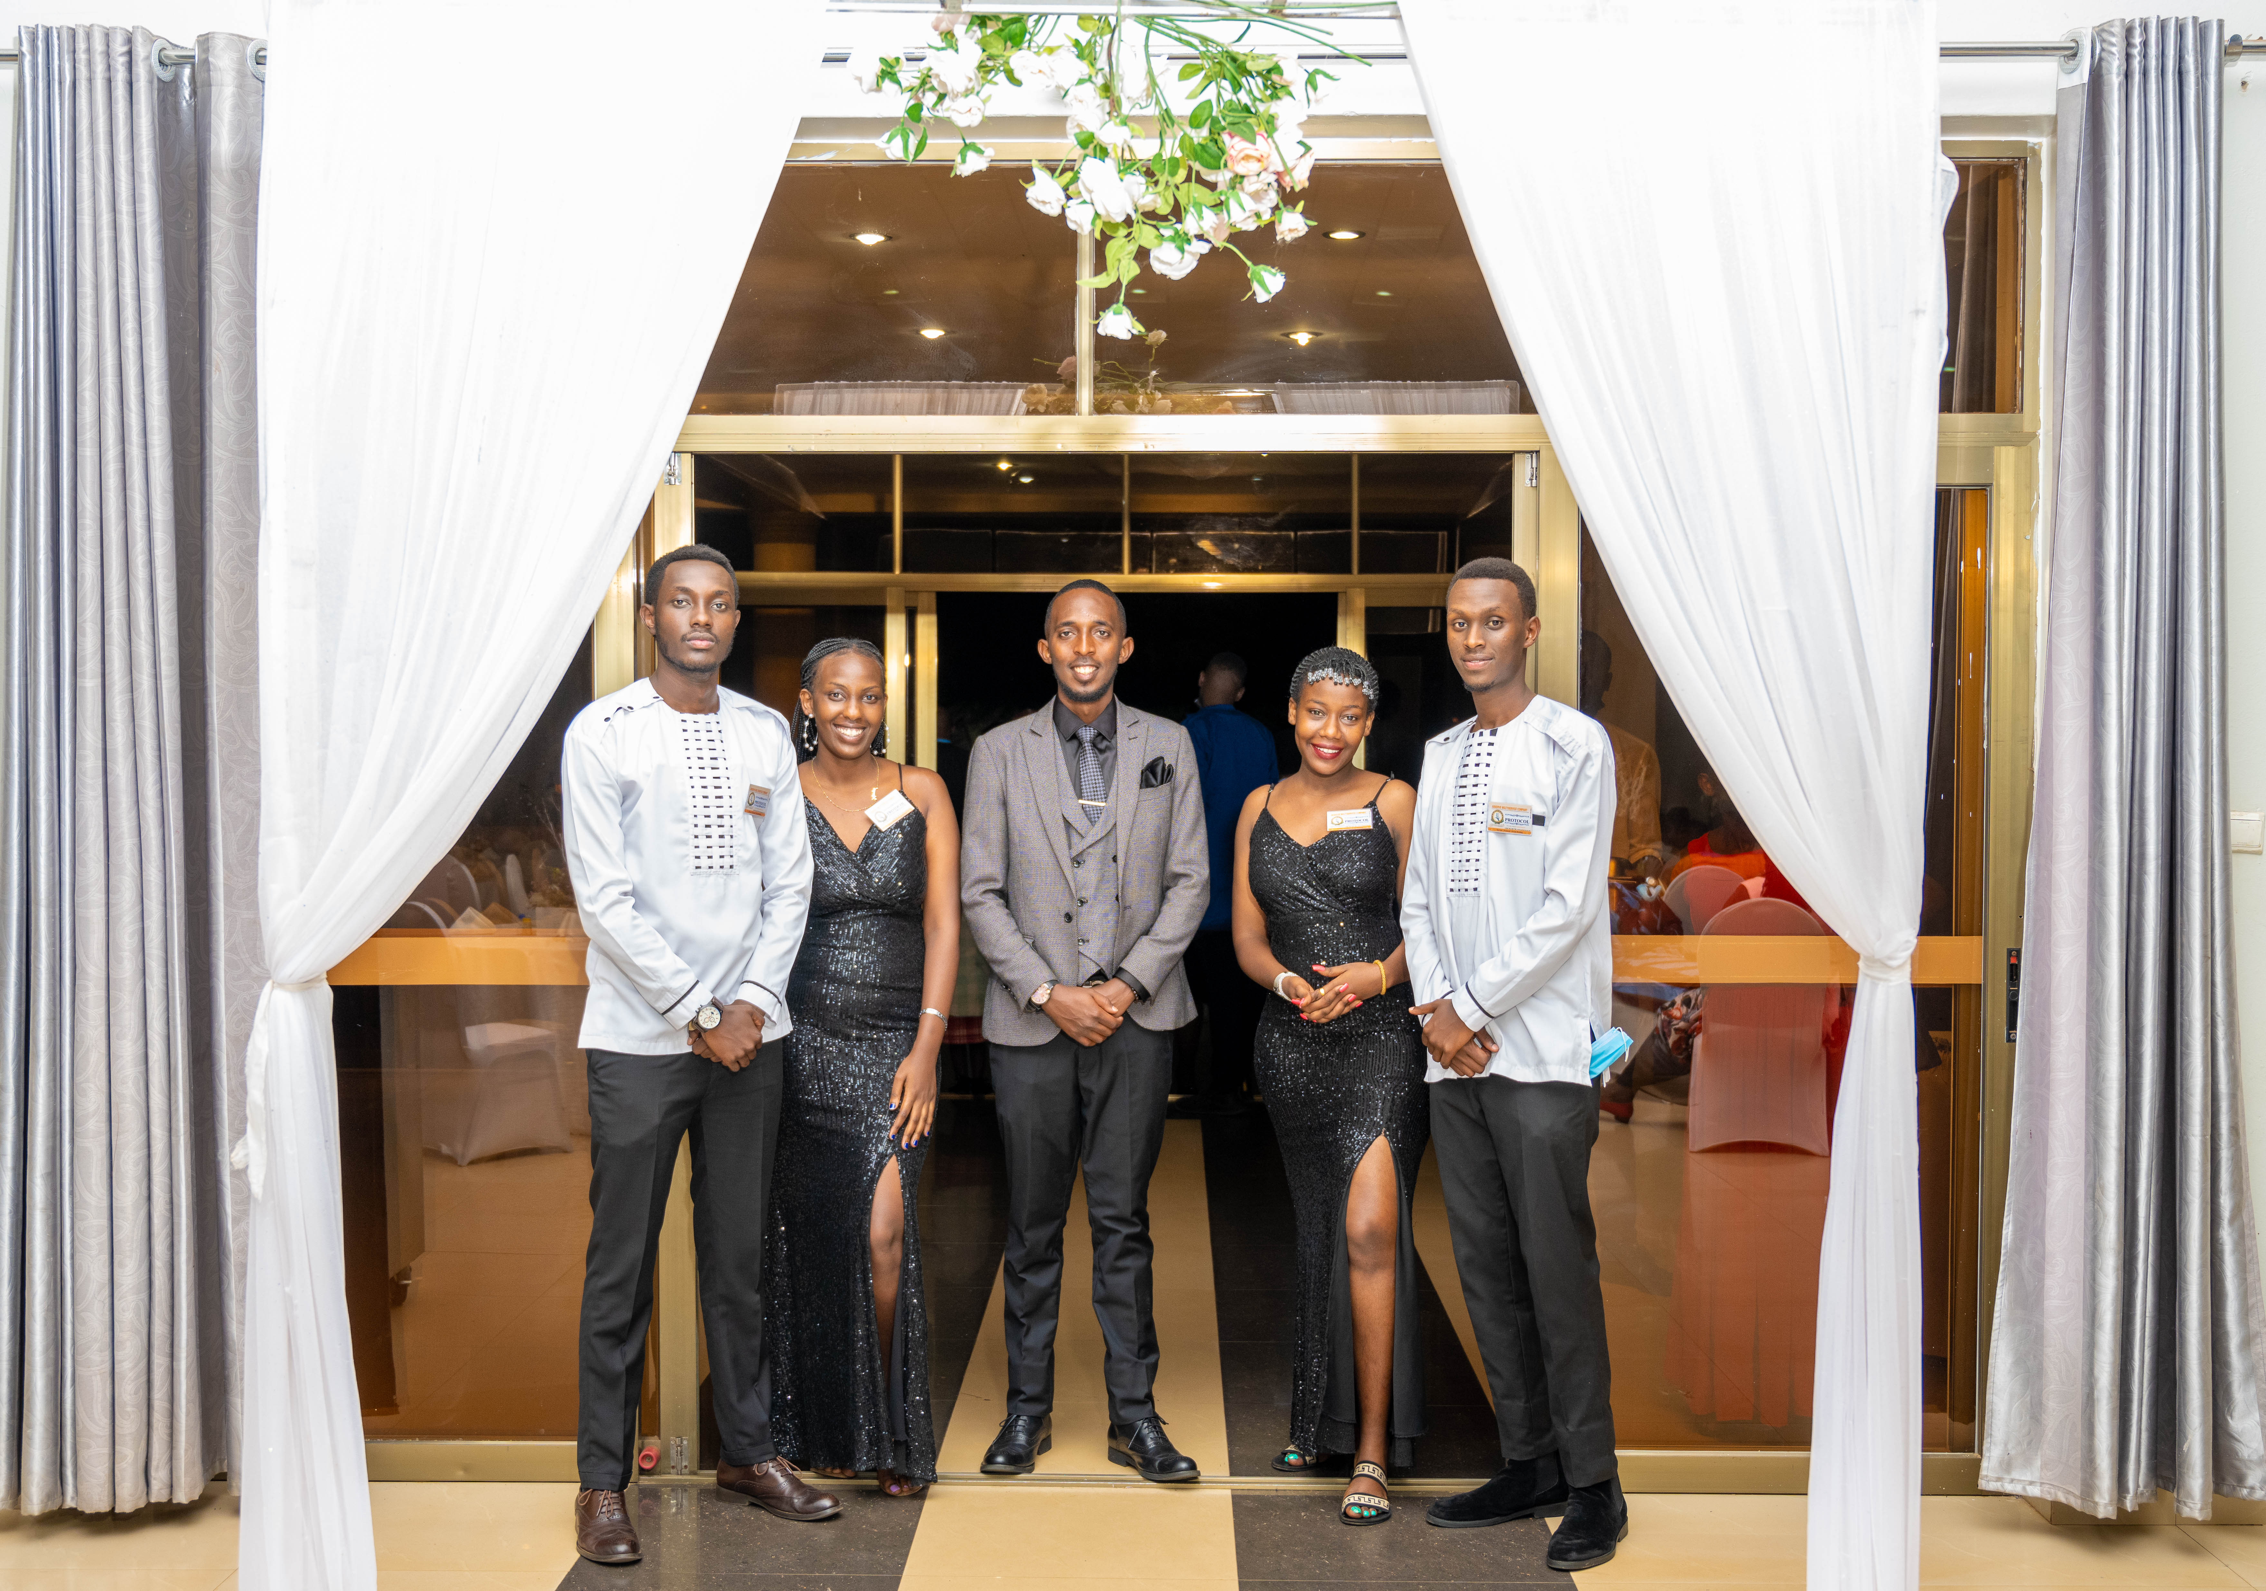
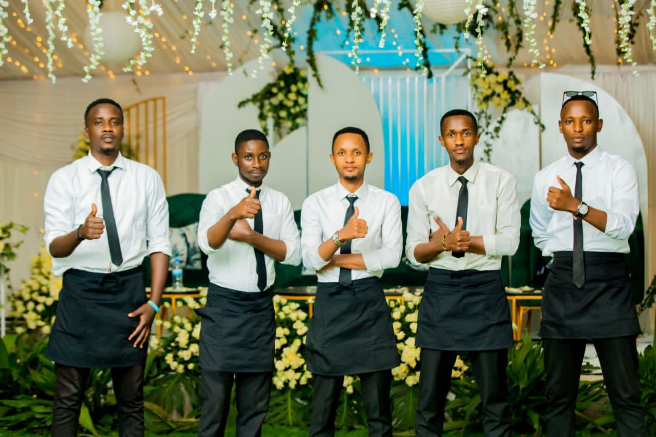
What we Provide
FOOD AND BEVERAGE SERVICE
PROTOCOL SERVICES
FOOD AND BEVERAGE CATERING
Where we are growing to provide
ENTERTAINMENT
VENUES
TRANSPORT
DECOR AND SETUP
SOUND AND VIDEO
PHOTOGRAPHY

Slide 8
